Slide 1
RAML To API Builder
|
|
1st June, 2020

Slide 2

Executor Summary | RAML To API Builder

Slide 3
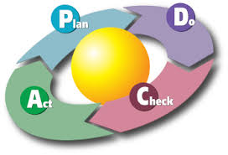
Enhancement Roadmap | RAML To API Builder
By following PDCA (plan-do-check-act) iterative steps to control and continual improvement following is Roadmap for future enhancement for this tool called “RAML to API Builder”
First Improvement
Second
Third
Fourth*

